Slide 1


Baseball VI
Produced by Dr. Mario | UNC STOR 390

Slide 2
Player Win Averages
Let p = Probability My Team Wins (%)
Let q = 100-p = Probability Opponent’s Team Wins
How Does an Individual Player Impact p?
Winning Probability Difference (WINDIFF)
WINDIFF Before Game Begins
Assume Each Team Equally Likely to Win
$WINDIFF_{t}=p_{t}−q_{t}$ where $t=Time$
$$WINDIFF_{0}=50−50=0$$

Slide 3
Player Win Averages
Jeff Sagarin
Developed Ranking Methods in Variety of Sports
Publishes Rankings in USA Today
Known for MLB Player Win Average Analysis (1957-2006)
To Avoid Decimals,
Scenario
Home Team Losing by 2 Runs in Bottom of 9th
Bases Loaded and Mariano Rivera Comes in to Pitch
Current WINDIFF
Batter Hits into Double Play and 1 Run Scores
Next WINDIFF
$SAGWINDIFF_{t}=10(p_{t}−q_{t})$ where $t=Time$
$$SAGWINDIFF_{t}=10\left(52.3−47.7\right)=46$$
$$SAGWINDIFF_{t+1}=10\left(17.2 −82.8\right)=−656$$

Slide 4
Player Win Averages
Scenario
Observe the Change in WINDIFF
Clearly, Swing Was in Mariano Rivera’s Favor
Batter Loses 702 Points
Mariano Gains 702 Points
How Does This Methodology Improve ERA?
Key Conversion: 2000 SAGWINDIFF = 1 WIN Above 500
Changes in SAGWINDIFF For Team = 1000 Points
Suppose Team Record is 82W and 80L
Across Season
Team Ends Season 1 Game Over .500
$$SAGWINDIFF_{t+1}−SAGWINDIFF_{t}=−656−46=−702$$
$$82×1000−80×1000=2000 Points$$

Slide 5
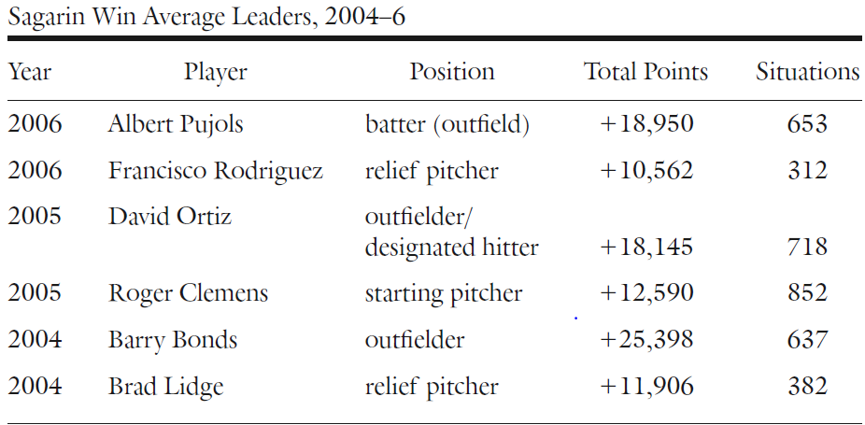
Player Win Averages
Win Average Leaders from 2004 to 2006

Slide 6

Player Win Averages
Applied to Fielding Ability
Use of Rating System by John Dewan’s Fielding Bible
Derek Jeter’s Rating was -34 (Caused 34 Hits More Than Average)
Derek Jeter Cost the Team
Adjust Derek Jeter’s Win Points by Subtraction
Historically, Fielding Has Been Overrated
Based on Fielding Bible, Only 7 Players with Positive Fielding Ratings Equivalent to 2 More Wins Above Average.
$$−34 Hits=−0.8×34 Runs=−27.2 Runs$$
$=−\frac{27.2}{10} Wins=−2000×2.72 Win Points$
$$=−5,440 Win Points$$

Slide 7
Player Win Averages
Applied to Baserunning Ability
Good Base Runner Described
Rarely Caught Stealing
Rarely Caught in Double Plays
Able to Take Extra Bases
Player Win Averages Reward Stolen Bases and Preventing Double Plays
Player Win Averages Do Not Reward
Fast Base Running is not Rewarded by Player Win Averages
Analyzed By Dan Fox (Director Of Baseball Informatics for Pirates)
Compare Runner’s Number of Runs to Average Runner
Best Base Running Has Little Effect on SAGWIN

Slide 8
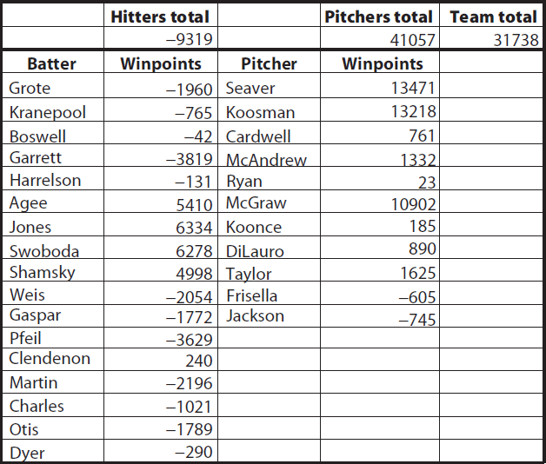
Player Win Averages
Interesting Application: Hitting Versus Pitching
1969 World Champion New York Mets
Table of Player Win Averages
Hitters = Bad
Pitchers = Good
Season 100 Wins
Expect 38,000 Win Points
Not Equal Because Trades
$$\left(100−81\right)×2000=38,000$$

Slide 9
Player Win Averages
Winning Probabilities for All Game Scenarios
Recall: p = Probability My Team Wins (%)
How is this Probability Calculated?
We Can Use a Massive Set of Play-by-Play Data (1977-2006)
Scenarios Based on Inning, Score, Runner Locations, and Outs
Problem Some Scenarios Are Rare
Advised to Use Markov Chain Monte Carlo (MCMC)

Slide 10
Value of Replacement Players
Winning Probabilities for All Game Scenarios
Recall: p = Probability My Team Wins (%)
How is this Probability Calculated?
We Can Use a Massive Set of Play-by-Play Data (1977-2006)
Scenarios Based on Inning, Score, Runner Locations, and Outs
Problem Some Scenarios Are Rare
Advised to Use Markov Chain Monte Carlo (MCMC)

Slide 11
Value of Replacement Players
Keith Woolner
Works for the Cleveland Indians
Authored for Baseball Prospectus
Respected for Player Analysis and Market Evaluation
Created Value of Replacement Player (VORP)
Replacement Player
Players Create Value by Keeping Bad Players Off the Field
Acquiring Replacement Players (Minor League)
Assume List of Replacement Players is Infinite
Woolner Defined Replacement Player as a Player in the Bottom 20% of List Ordered by Plate Appearances
Team of Replacement Players Would Get Approximately 44 Wins and 118 Losses

Slide 12
Value of Replacement Players
PA = Plate
Appearance
BFP = Batters Faced
Value of a Replacement Player Points (VORPP)
Recall: Each Loss Below .500 = -2,000 SAGWIN
For All Replacement Players = -74,000 SAGWIN
Batters and Pitchers Get Equal Blame = -37,000 SAGWIN Points Each
Approximately 6,200 Plate Appearances in a Season
Formula for Hitters
Formula for Pitchers
$$\frac{−37,000}{6,200}=−5.97 Points Per Plate Appearance$$
$$VORPP=SAGWIN+5.97×(PA)$$
$$VORPP=SAGWIN+5.97×(BFP)$$

Slide 13
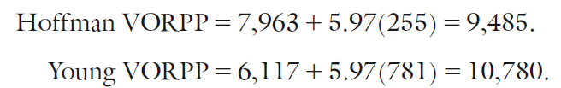
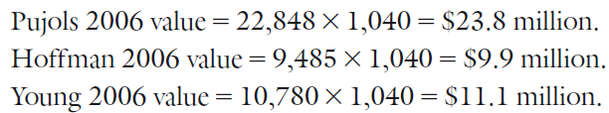
Value of Replacement Players
VORPP Used to Evaluate Trades
VORPP Used to Determine Salary
$$\$77M=74,000 VORPP$$
$$\$1,040=1 VORPP$$

Slide 14
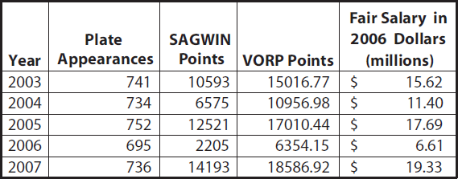
Value of Replacement Players
Was Alex Rodriguez Overpaid by Yankees? Yes
Deal: $275M for 10 Years
Fair Deal Based Off 2007 Statistics
$$\$19.33M×1.05×10≈\$202M$$

Slide 15

Value of Replacement Players
Extra Plate Appearances Create Value
VORPP Used by Theo Epstein in 2004 Red Sox Season

Slide 16
Wins Above Replacement
Wins Above Replacement (WAR)
Attempt to Measure All of a Baseball’s Player’s Contributions
What is it good for? Absolutely Everything
Not Comparing to Average Player but Replacement Player
Interpretation: “If a player got injured and their team had to replace them, how many wins would the team be losing?
Three Main Sources of WAR
Baseball-Reference (bWAR)
FanGraphs (fWAR)
Baseball Prospectus (WARP)

Slide 17

Wins Above Replacement
Formula Differs for Position Players and Pitchers
Position Players: Batting, Baserunning, and Fielding Measured in Runs Above Average (RAA)
Pitchers: Either Based on Runs Allowed Per 9 Innings (RA9) or Fielding Independent Pitching (FIP)
General Formula for Position Players (fWAR)

Slide 18
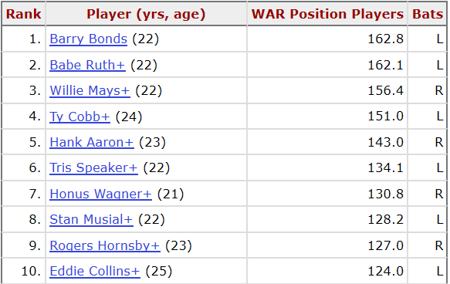
Wins Above Replacement
Top Players for bWAR Based on Career

Slide 19
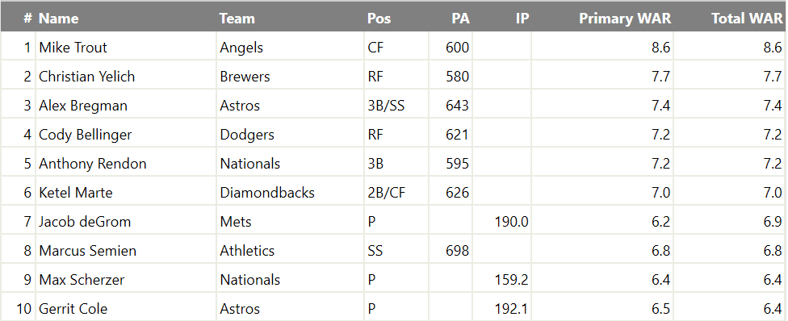
Wins Above Replacement
Top Players for fWAR Based on 2019 Season

Slide 20

Final Inspiration
Yesterday’s home runs don’t
win today’s games.
-Babe Ruth

